Slide 1

Northern Climate
HVAC SERVICES
PREVENTIVE MAINTENANCE
Commercial HVAC
Solutions
Faster response. Lower energy waste. Less downtime.
24/7 SERVICE
RETROFITS
MAINTENANCE
Business Presentation
Heating • Cooling • Ventilation • Controls
Comfort • Efficiency • Uptime
Company Name | 000-000-0000 | info@company.com | www.company.com
1
Notes:
Introduce the HVAC company as a practical field-service partner for commercial and industrial facilities.

Slide 2
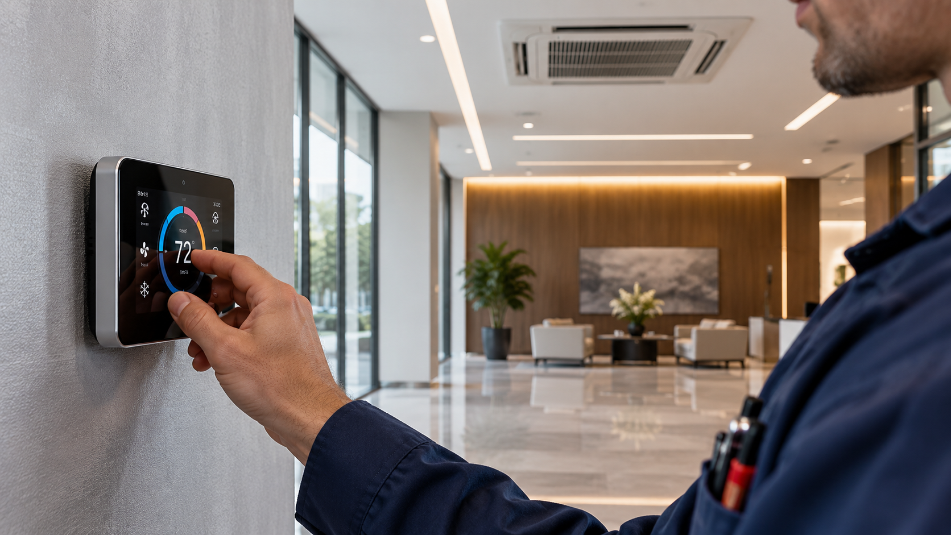
Northern Climate
HVAC SERVICES
Buildings Need Climate Control That Performs.
HVAC affects comfort, energy cost, tenant satisfaction and business continuity.
Responsive service when equipment fails.
Predictable maintenance before peak season.
Lower operating cost through smarter controls.
Comfort • Efficiency • Uptime
Company Name | 000-000-0000 | info@company.com | www.company.com
2
Notes:
Describe the pain points: reactive repairs, rising utility costs, comfort complaints, and pressure to keep buildings open.

Slide 3

Northern Climate
HVAC SERVICES
Complete HVAC Service Workflow.
Assessment → Service Plan → Installation / Repair → Commissioning → Maintenance
FACILITY ASSESSMENT: equipment age, load, condition and comfort issues.
SYSTEM DESIGN: right-sized recommendations and priority scope.
FIELD SERVICE: dispatch, repair, replacement and startup support.
REPORTING: maintenance records, lifecycle planning and budget support.
Comfort • Efficiency • Uptime
Company Name | 000-000-0000 | info@company.com | www.company.com
3
Notes:
Walk through the end-to-end workflow and show how the HVAC company reduces uncertainty for facility managers.

Slide 4
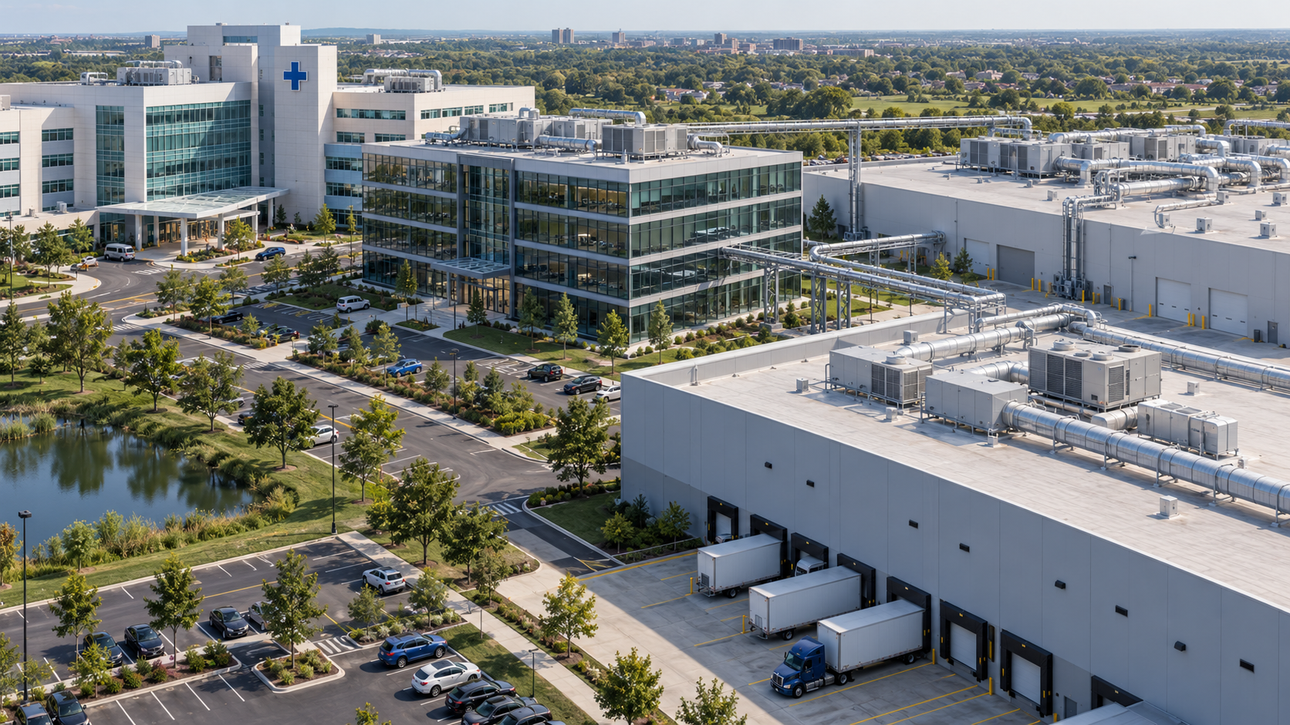
Northern Climate
HVAC SERVICES
Built for Commercial and Industrial Facilities.
One service model. Many building types.
OFFICES & RETAIL: comfort, air quality and tenant satisfaction.
WAREHOUSES & LOGISTICS: heating, ventilation and dock-area comfort.
HEALTHCARE & INSTITUTIONAL: reliability and preventive maintenance.
INDUSTRIAL PLANTS: process-adjacent ventilation and equipment uptime.
Comfort • Efficiency • Uptime
Company Name | 000-000-0000 | info@company.com | www.company.com
4
Notes:
Position the HVAC company across commercial, institutional and industrial verticals.

Slide 5

Northern Climate
HVAC SERVICES
Prove the Savings Before the Work Starts.
Example planning scenario: preventive maintenance plus controls tuning.
100,000 sq. ft. facility.
Illustrative annual operating improvement.
$48K
$36K
REACTIVE REPAIRS
PLANNED PROGRAM
$12K
LOWER
Comfort • Efficiency • Uptime
COST AVOIDANCE
DOWNTIME RISK
Savings come from planned maintenance, fewer emergency calls, improved controls and extended equipment life.
Company Name | 000-000-0000 | info@company.com | www.company.com
5
Notes:
Use this slide to show that the client can evaluate value before approving work. Replace sample numbers with actual estimates.

Slide 6

Northern Climate
HVAC SERVICES
Planning Tools + Field Execution.
Faster HVAC decisions, clearer budgets and better building performance.
PLANNING: site assessment, asset list and priority map.
FINANCIAL: repair/replace comparison and budget-ready estimates.
OPERATIONS: maintenance schedule and dispatch-ready service plan.
REPORTING: client-ready summaries for ownership and facility teams.
Comfort • Efficiency • Uptime
Company Name | 000-000-0000 | info@company.com | www.company.com
6
Notes:
Describe the company’s method: assess, prioritize, quote, schedule, execute and report.

Slide 7

Northern Climate
HVAC SERVICES
Schedule a No-Obligation HVAC Assessment.
Could your building handle a heating or cooling failure this week?
Northern Climate HVAC Services
Contact Name
000-000-0000
info@company.com
www.company.com
SCHEDULE A NO-OBLIGATION ASSESSMENT →
Comfort • Efficiency • Uptime
SERVICE - MAINTENANCE - RETROFITS - CONTROLS
Company Name | 000-000-0000 | info@company.com | www.company.com
7
Notes:
Close with a clear call to action for a site assessment or service review.

